Slide 1
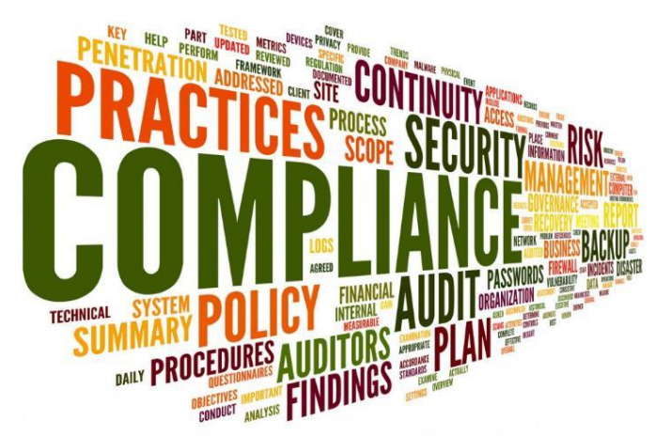
Chapter 1. Computer Security Concepts

Slide 2
Outline
What is Information Security?
Why is it important?
What can we do?
Security concepts

Slide 3
What is Information Security?
Deals with several different "trust" aspects of information and its protection
Def 1:
Information security, often referred to as InfoSec, refers to the processes and tools designed and deployed to protect sensitive business information from modification, disruption, destruction, and inspection. (Ref: Cisco.com)

Slide 4
What is Information Security?
Def 2:
Information security is the practice of preventing unauthorized access, use, disclosure, disruption, modification, inspection, recording or destruction of information.
The information or data may take any form, e.g. electronic or physical. Information security's primary focus is the balanced protection of the confidentiality, integrity and availability of data (also known as the CIA triad) while maintaining a focus on efficient policy implementation, all without hampering organization productivity.
This is largely achieved through a multi-step risk management process that identifies assets, threat sources, vulnerabilities, potential impacts, and possible controls, followed by assessment of the effectiveness of the risk management plan. (Ref: wikipedia)

Slide 5
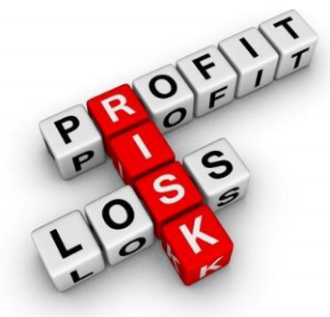
What is Information Security?
The U.S. Government’s National Information Assurance Glossary defines INFOSEC as:
“Protection of information systems against unauthorized access to or modification of information, whether in storage, processing or transit, and against the denial of service to authorized users or the provision of service to unauthorized users, including those measures necessary to detect, document, and counter such threats.”

Slide 6
What is Information Security?
Three widely accepted elements or areas of focus (referred to as the “CIA Triad”):
Confidentiality
Integrity
Availability (Recoverability)
Includes Physical Security as well as Electronic

Slide 7
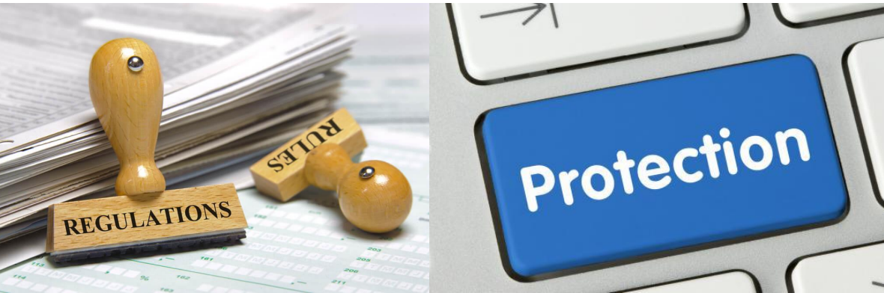
Why is InfoSec Important?
Information security is not an 'IT problem', it is a business issue.

Slide 8
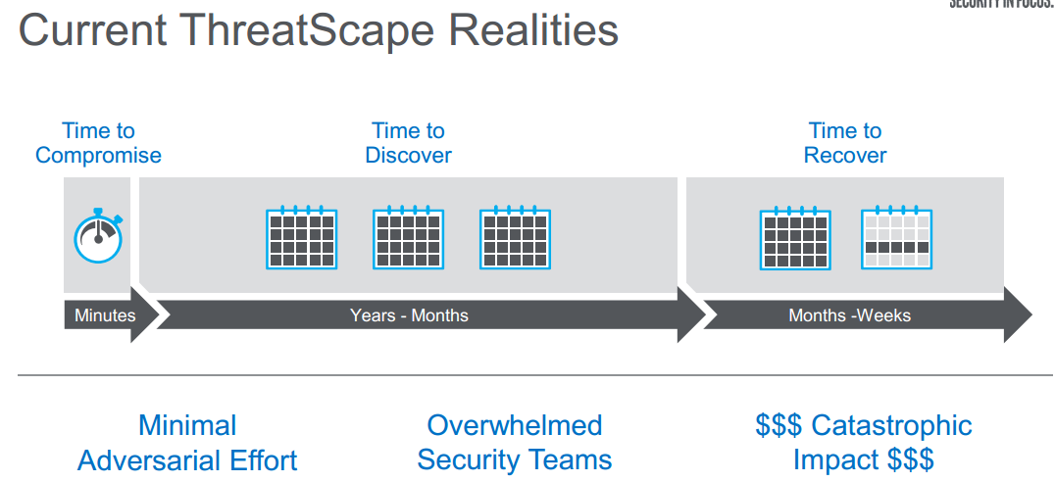
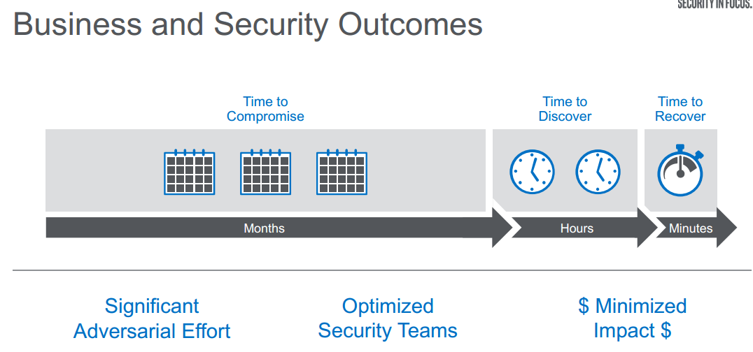

Slide 9

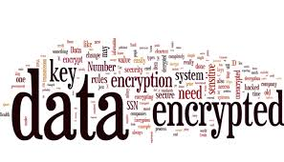
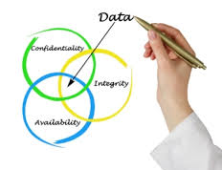
Main goals of Information Security
Confidentiality:only authorized entities have access to the data
Integrity: there are no unauthorized modifications of the data
Availability: authorized entities can access the data when and how they are permitted to do so
(C-I-A Triad)

Slide 10
What can we do?
Security Assessment
Identify areas of risk
Identify potential for security breaches, collapses
Identify steps to mitigate
Security Application
Expert knowledge (train, hire, other)
Multi-layered Approach (there is no single solution)
Policies and Procedures

Slide 11
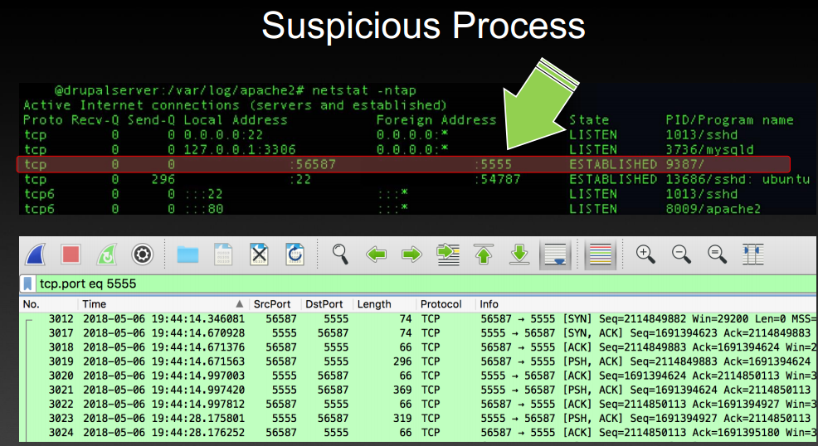
What can we do?
Security Awareness
Not just for the geeks!
Security Training at all levels (external and/or internal)
Continuing education and awareness – not a one-time shot!
Make it part of the culture

Slide 12
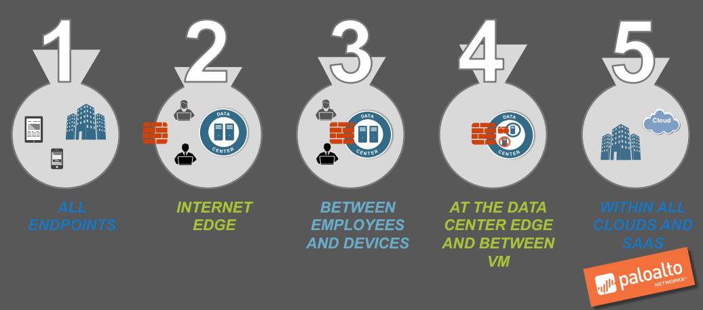
What can we do?

Slide 13
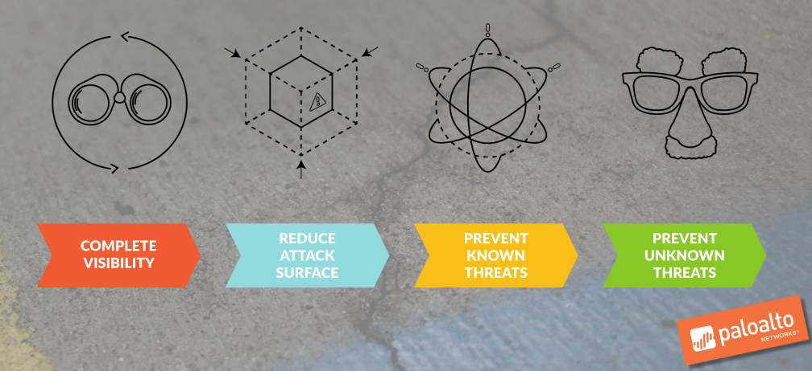
What can we do?

Slide 14
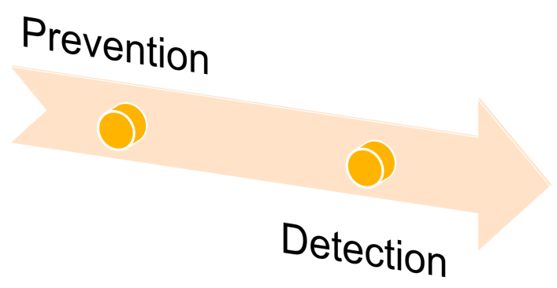
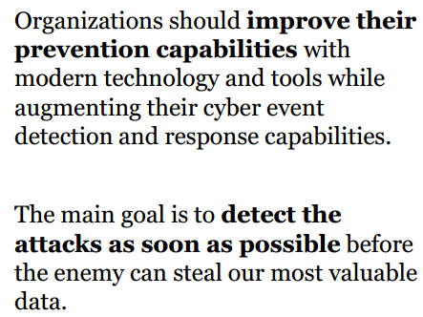
What can we do?

Slide 15
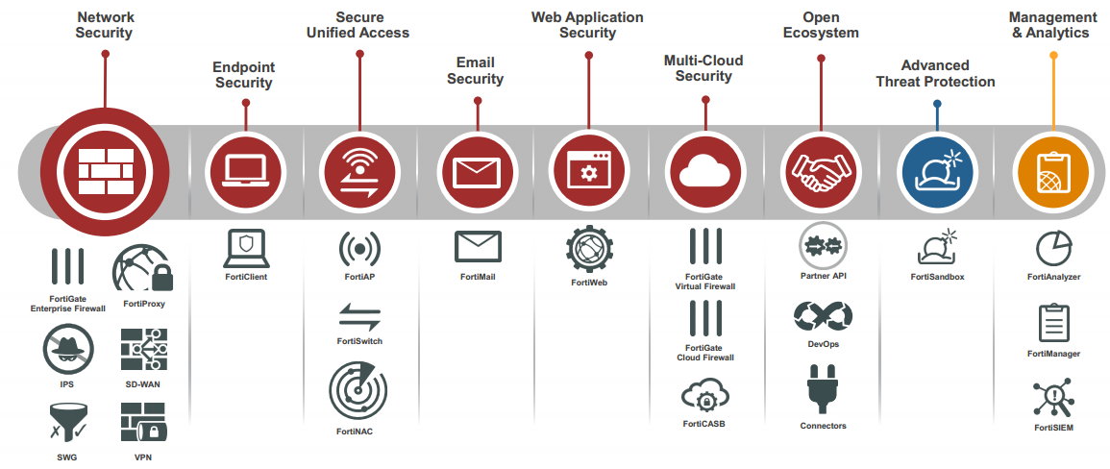
What can we do?

Slide 16
Principle of Least Privilege
Every program and every privileged user of the system should operate using the least amount of privilegs necessary to complete the job

Slide 17
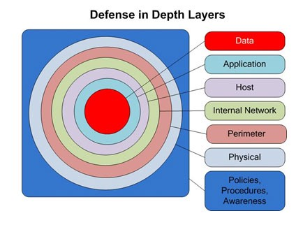
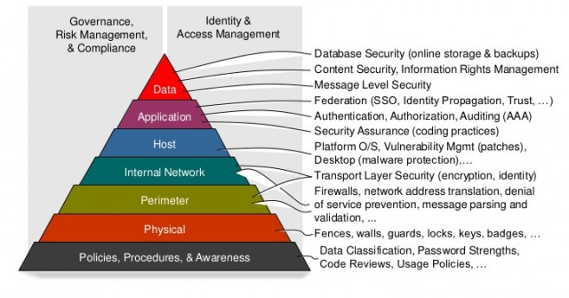
What can we do?
Defense in depth

Slide 18
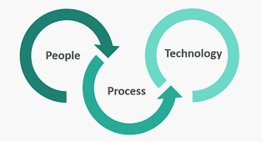
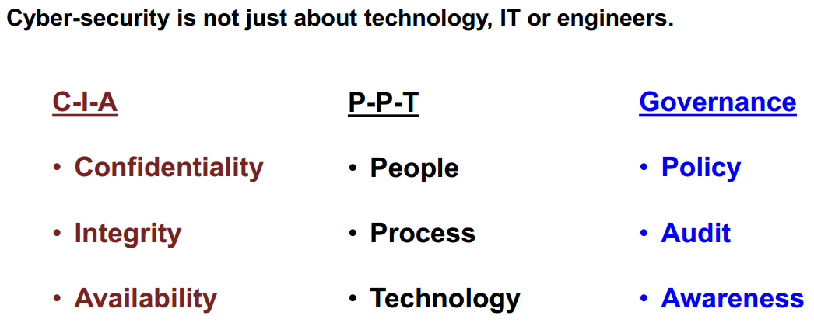
What can we do?

Slide 19
Security Concepts
Computer security
involves implementing measures to secure a single computer (protecting the resources stored on that computer and protecting that computer from threats)
Network security
involves protecting all the resources on a network from threats (computers on the network, network devices, network transmission media, and the data being transmitted across the network)

Slide 20
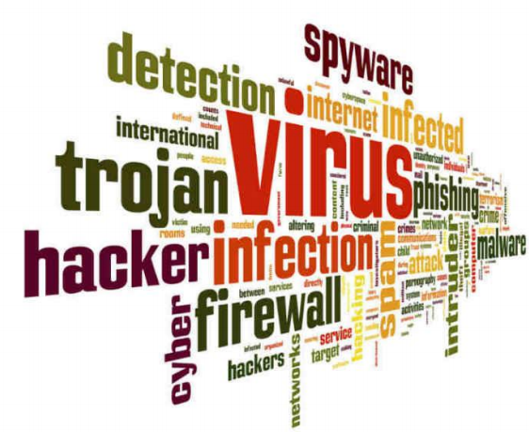
Security Concepts
Authentication
Authorization
Accounting
Access control
Nonrepudiation
The ability to ensure that someone cannot deny his/her actions

Slide 21
Security Control Frameworks
This is a notional construct outlining the organization’s approach to security, including a list of specific security processes, procedures, and solutions used by the organization. Some frameworks:
ISO 27001/27002
COBIT
ITIL
RMF
CSA STAR

Slide 22
Summary
Objective of InfoSec is Confidentiality, Integrity and Availability…protect your systems and your data
Threats are numerous, evolving, and their impact is costly
Security should be applied in layers (“road blocks”)
Security Awareness at all levels must be maintained
Failure to Secure is an Opportunity to Fail

Slide 23
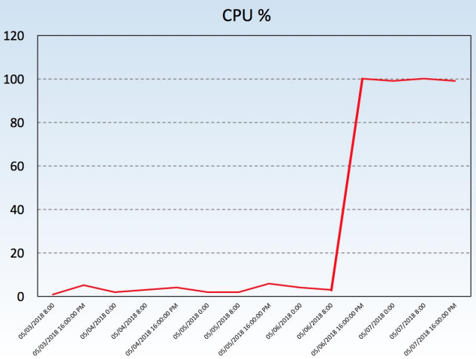
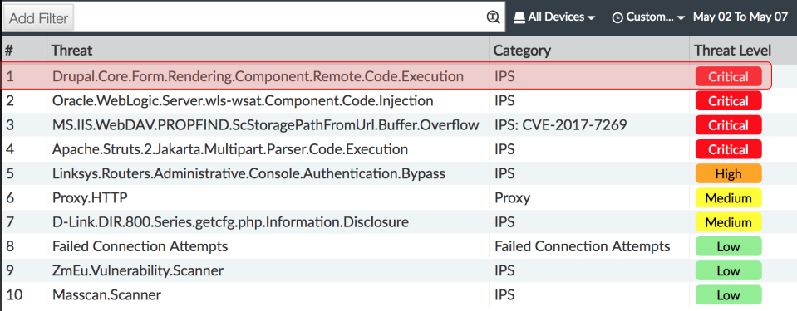
Q&A

Slide 24
Questions (MQCs)

Slide 25
Q1. Message ………..means that the data must arrive at the receiver exactly as sent
Confidentiality
Integrity
Authentication
None of the above
Answer: B

Slide 26
Q2. Cryptography does not concern itself with:
A. Availability
B. Authenticity
C. Integrity
D. Confidentiality
Answer: A

Slide 27
Q3. An access control system that grants users only those rights necessary for them to perform their work is operating on which security principle?
A. Discretionary Access
B. Least Privilege
C. Mandatory Access
D. Separation of Duties
Answer: B

Slide 28
Q4. Which of the following is the verification of a person’s identity?
Authorization
Accoutability
Authentication
Password
Answer: C

Slide 29
Q5. John is concerned about social engineering. He is particularly concerned that this technique could be used by an attacker to obtain information about the network, including possibly even passwords. What countermeasure would be most effective in combating social engineering?
SPI firewall
An IPS
User training
Strong policies
Answer: C

Slide 30
Q6. The application of which of the following standards would BEST reduce the potential for data breaches?
A. ISO 9000
B. ISO 20121
C. ISO 26000
D. ISO 27001
Answer: D

Slide 31
Q7. The first phase of hacking an IT system is compromise of which foundation of security?
Availability
Confidentiality
Integrity
Authentication
Answer: B

Slide 32
Q8. The PRIMARY purpose of a security awareness program is to?
A. Ensure that everyone understands the organization's policies and procedures.
B. Communicate that access to information will be granted on a need-to-know basis.
C. Warn all users that access to all systems will be monitored on a daily basis.
D. Comply with regulations related to data and information protection.
Answer: A

Slide 33
Q9. Which type of cyber attack is commonly performed through emails?
Trojans
Phishing
Worms
Ransomware
Answer: B

Slide 34
Q10. The use of strong authentication, the encryption of Personally Identifiable Information (PII) on database servers, application security reviews, and the encryption of data transmitted across networks provide
A. Data integrity.
B. Defense in depth.
C. Data availability.
D. Non-repudiation.
Answer: B

